Slide 1
Accidents & Their Effect on Industry
Lecture 07
Syeda Farwa Rizvi

Slide 2
Contents
Costs of accidents
Time lost
Work injuries
Parts of the body injured on the job
Chemical Burn injuries
Construction injuries
Fire injuries

Slide 3
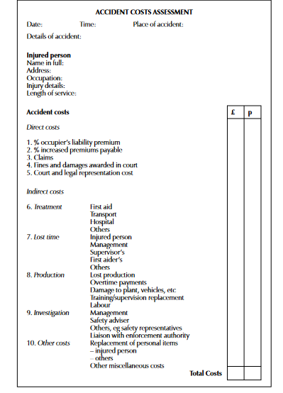

Slide 4
Work injuries
Workplace injuries are injuries or illnesses that occur in relation to an employee’s job.
Generally, a workplace injury occurs because the work environment is unsafe (the premises are dangerous, the equipment is defective, or the environment is contaminated with hazardous chemicals).
In addition, jobs that require repetitive or difficult movements (eg. factory labor or heavy lifting) may cause injury.

Slide 5
Types of Workplace Injury

Slide 6
Falls and Other Traumatic Injuries
Falls are common among construction workers, miners, and factory employees.
Many construction accidents involve falls from defective ladders or scaffoldings.
A fall from several stories up can break bones, cause internal injuries, and even result in permanent paralysis or death.
Workers who do sustain such injuries can expect to miss a significant period of time at work while recovering, and many are never able to return.

Slide 7
Repetitive Motion Injuries
Repetitive motion injuries are the result of performing one characteristic movement over and over.
For instance, many workers who spend their days typing at a computer keyboard without proper ergonomic protection suffer carpal tunnel syndrome, rendering many incapable of continuing to type for long periods.
Employers are required to foresee such risks and provide appropriate protection to their employees.

Slide 8
Chronic Exposure Conditions
Many high-risk jobs involve exposure to toxic substances.
Miners and industrial workers whose jobs require working with hazardous chemicals and minerals are entitled to appropriate safety equipment and other safeguards to prevent illness due to chronic exposure.
The classic example of this scenario is asbestos exposure.
Those who were exposed to asbestos in the mid- to late-20th century have since developed mesothelioma and other life-threatening health problems because they were not sufficiently protected.

Slide 9
Psychological and Emotional Trauma
Not all workplace injuries are physical in nature.
Many workers develop severe psychological problems due to the nature of their work.
A hostile workplace environment, in which some workers are the victims of discrimination or abuse based on gender, race, sexual orientation, religion, or other factors, can be psychologically and emotionally devastating.
Many workers in extremely hazardous or high-stress jobs develop stress-related disorders that require costly treatment and render them unable to continue working.

Slide 10
Common Causes of Workplace Injuries

Slide 11
Defective or Hazardous Equipment
Hazardous Materials
Repetitive Motion
Motor Vehicle Mishaps
Insufficient Safety Guidelines
Insufficient Training
Reckless Co-worker Conduct

